Slide 1
Genetic Edition

Slide 2
History of the TEI textual model
In the beginning there was <text>.
Thou shalt not make unto thee any graven image
→ <facsimile> was introduced nonetheless.
The Fourth Dimension → text on a page over time → <sourceDoc>

Slide 3
Genetic edition principles
Fact vs. Interpretation e.g. mod vs. add/del
Status vs. Process e.g. change
Document vs. Text e.g. pb/cb/lb/gb, @place
Writing Acts vs. Text Stages

Slide 4
Genetic edition
An embedded transcription is one in which words and other written traces are encoded as subcomponents of elements representing the physical surfaces carrying them rather than independently of them.
<sourceDoc> contains a transcription or other representation of a single source document potentially forming part of a dossier génétique or collection of sources.

Slide 5
sourceDoc
<sourceDoc>
<surface facs="page1.png">
<zone>All the writing on page 1</zone>
</surface>
<surface>
<graphic url="page2.png"/>
<zone>
<line>A line of writing on page 2</line>
<line>Another line of writing on page 2</line>
</zone>
</surface>
</sourceDoc>

Slide 6
sourceDoc → all lines
<sourceDoc> consists of
<surface>s, on which one can define
<zone>s that can be diveded into
<line>s which may contain
<seg>s.

Slide 7
Module transcr
Elements defined:
addSpan am damage damageSpan delSpan ex facsimile fw handNotes handShift subst supplied
line listTranspose metamark mod redo restore retrace sourceDoc space substJoin surface surfaceGrp surplus transpose undo zone
Many other elements have been moved to the core module.

Slide 8
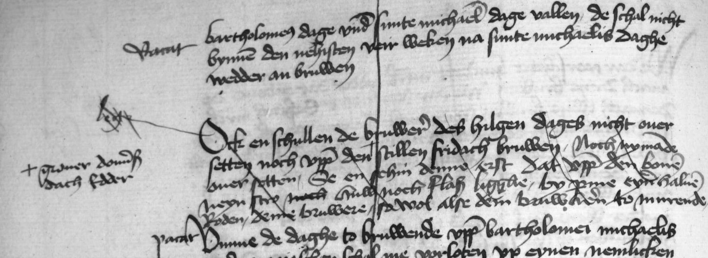
Example
<delSpan spanTo="#endDel" change="#L3"/>
<metamark function="flag" target="#zone-1"
change="#L2">lege</metamark>

Slide 9
Example
<zone xml:id="zone-1" change="#L1">Ock en schullen de bruwere des hilgen dages nicht over setten noch uppe den stillen fridach bruwen.</zone>
<addSpan spanTo="#endDel" change="#L2"/>

Slide 10
Example
<zone>Noch nymande over setten, […] dem bruwheren to murende.</zone>
<anchor xml:id="endDel"/>

Slide 11
metamark
<metamark> contains or describes any kind of graphic or written signal within a document the function of which is to determine how it should be read rather than forming part of the actual content of the document
@function describes the function of the mark (e.g. status, insertion, deletion, transposition)
@change indicates the sequencing of interventions

Slide 12
mod
<mod> represents any kind of modification identified within a single document.
The letter T is written and then immediately deleted
The word The is written, deleted, and replaced by the word His
The added word His is then deleted
The initial letter i of the words iron necklace is overwritten with a capital I

Slide 13
mod
<line>
<del instant="true">T</del>
<mod type="subst">
<del>The</del>
<add place="above">
<del rend="overstrike">His</del>
</add>
</mod>
<mod type="subst">
<del rend="overwritten">i</del>
<add place="superimposed">I</add>
</mod>ron necklace
</line>

Slide 14
redo/undo
A writer may indicate that an alteration is itself to be altered.
<line>This is <del change="#s2" rend="overstrike">
<undo spanTo="#Xa" rend="dotted"
change="#s3"/>just some <anchor xml:id="Xa"/> sample <undo spanTo="#Xb" rend="dotted"
change="#s3"/>text, <anchor xml:id="Xb"/> we need</del>
<add change="#s2">not</add> a real example.</line>

Slide 15
retrace
<retrace> contains a sequence of writing which has been retraced, for example by over-inking, to clarify or fix it.
Examples:
<line>... Sku<retrace cause="unclear">l</retrace>dren </line>
<line>ved Bæg<retrace cause="unclear" change="#stage2">
<retrace cause="unclear" change="#stage1">er</retrace>
</retrace> ...</line>

Slide 16
space
<space> indicates the location of a significant space in the text
@resp
@dim (dimension) indicates whether the space is horizontal or vertical
att.dimensions (@unit, @quantity, @extent, @precision, @scope)

Slide 17
surplus
<surplus> marks text present in the source which the editor believes to be superfluous or redundant
Example:
I am dr Sr yrs
<surplus reason="repeated">yrs</surplus>
Sydney Smith

Slide 18
transpose
A transposition occurs when metamarks are found in a document indicating that passages should be moved to a different position.
<line>
<seg xml:id="ib01">bör</seg>
<metamark rend="underline" function="transposition" target="#ib01" place="above">2.</metamark> og <seg xml:id="ib02">hör</seg>
<metamark rend="underline" function="transposition" target="#ib02" place="above">1.</metamark>
</line>
<listTranspose>
<transpose>
<ptr target="#ib02"/>
<ptr target="#ib01"/>
</transpose>
</listTranspose>

Slide 19
Changes
A major purpose of genetic editing is the identification of ‘revision campaigns’ or, more generally, changes.
Alterations may precede or follow another or are related to other in any way.
<creation> (within the TEI header profile description) contains all information relating to the genesis or production of a text.
It may contain a listChange element which contains a number of change elements, one for each identified change

Slide 20
creation
<profileDesc>
<creation>
<listChange ordered="true">
<change xml:id="ST-1">First stage, written in ink </change>
<change xml:id="ST-2">Second stage, with revisions written in the author's hand using pencil</change>
<change xml:id="ST-3">Fixation of the pencilled revisions together with further revisions in the author's hand using ink</change>
<change xml:id="ST-4">Additions in a different hand, probably at a later stage</change>
</listChange>
</creation>
</profileDesc>

Slide 21
Note: creation vs. revision
The <listChange> element may be used also for documentation of changes to the TEI file, only then it is put into the <revisionStmt>.

